Slide 1



Smart Academic Advising
Data, Automation, and Strategic Student Success Interventions
Presenter: Maged Soliman
Student Affairs Best Practices Seminar
Prince Mohammad Bin Fahd University

Slide 2
Academic Advising

Slide 3


Academic Advising

Slide 5
Introduction
Academic Advising Overview
Holistic Academic Advising
Identifying at-risk students
Technologies utilized:
Degreeworks
GPA Calculator
Banner
Blackboard
E-appointment (virtual Advising)
E-portfolios
Survey
Social Media
Academic Advising

Slide 6


Importance of academic advising in student success
Student Retention and Success
Tailored Study Plan
Career Advising
Improvement of Academic Performance
Development of critical skills (PMU Core Competenices)
Academic Advising

Slide 7
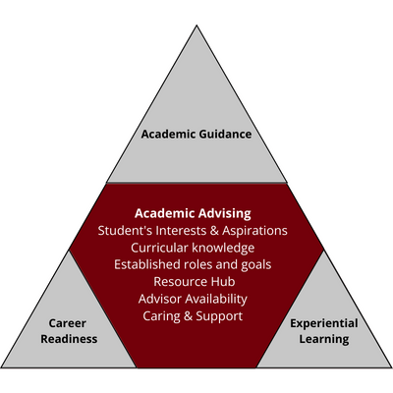
Functions of Academic Advising
Educational Planning and Goal Setting:
Course Selection
Degree Planning
Setting Academic Goals:
Support Academic Support
Tutoring
Writing centers
Study groups
Information Dissemination:
Policies and Procedures
Academic policies
Graduation requirements
Institutional procedures
Developmental Advising
Skill Development
Self-Awareness
Independence
Academic Advising

Slide 8
The Procedures to deal with at-risk students
Procedures for at-risk students
Assessment and Reflection
discuss the reasons
⁠Identify specific challenges
create a tailored study plan
Academic Support
Customized study plan focusing on specific courses
Use of tutoring services or study groups
Goal Setting
Set realistic short and long-term academic goals
Regularly review and adjust goals
Time Management
Enhance organizational skills
Teach effective scheduling techniques
Emphasize the importance
Academic Skills Workshops
Offer workshops
Provide resources
Monitoring and Evaluation
⁠Implement a system for monitoring academic progress
Academic Advising

Slide 9



Technologies utilized for academic advising
DEGREEWORK
GPA CALCULATOR
BANNER
E-APPOINTMENT (virtual Advising)
Academic Advising
SURVEY
BLACKBOARD
E-PORTFOLIOS
SOCIAL MEDIA

Slide 10
Success Stories
Overall Comparative Analysis of Academic standings between 2016-2019 and 2020-2023
# | 2016-2019 | 2020-2024
AD | 159 | 60
GD | 28 | 27
CGPA<2 | 22 | 10
R1 & R2 | 36 | 1
Explusion | 1 | 0
Academic Advising

Slide 11
CONCLUSION
Academic advising is essential for fostering a supportive and effective learning environment
Not only helps students achieve their academic and career goals but also enhances the overall educational experience, contributing to higher retention and graduation rates, student satisfaction, and institutional success
Academic Advising

Slide 12

Prince Mohammad Bin Fahd University
CREATIVE MINDS… TRANSFORM THE WORLD
11

Slide 13
THANK
Academic Advising
YOU
pmu.edu.sa

